Slide 1

PA Department of Labor & Industry
OFFICE OF UNEMPLOYMENT COMPENSATION
UC-101
updated 05/28/20

Slide 2
The goal of this training
To provide a general understanding on Unemployment Compensation and how it works.
To review the Federal Programs offered through the CARES Act.
To assist Claimants with general information on Unemployment Compensation.

Slide 3
UC-101 AGENDA
Who may be Eligible?
When and How to Open a UC Claim
What UC Mailings the Claimant will Receive
UC Eligibility Requirements
Filing Biweekly Claims
Changes to Requirements and Important Tips
Contacting UC
Federal Pandemic Unemployment Compensation (FPUC)
Pandemic Unemployment Assistance (PUA)
Pandemic Emergency Unemployment Compensation (PEUC)

Slide 4
UC Eligibility and Covid-19
An individual may be eligible for UC benefits if:
Their employer temporarily closes or goes out of business because of COVID-19
Their employer reduces their hours because of COVID-19
They have been told not to work because their employer feels they might get or spread COVID-19
They have been told to quarantine or self-isolate, or live/work in a county under government-recommended mitigation efforts
Even if their regular working hours are considered part-time

Slide 5
WHEN AND HOW TO OPEN A UC CLAIM
When do I apply?
An individual has the right to file an application during the first week they work less than their normal or regular hours.
The week they open their claim is considered their Application for Benefits Date, or AB Date. This is the date their claim is effective. The AB date of their claim is always the Sunday immediately preceding the day that they opened their claim. (Delaying filing an application could cost them benefits)

Slide 6
WHEN AND HOW TO OPEN A UC CLAIM
Where do I apply?
Applications can be filed beginning with the first week affected anytime on our website www.uc.pa.gov
  Internet applications are processed by UC Service Centers located throughout the state. If additional info is needed from the application filed online, we will reach out to them directly.
If internet is not available, telephone calls to our UC Service Centers are accepted on Monday through Friday, 8 AM to 4 PM, at 888-313-7284.
  (TTY: 888-334-4046)
If an individual is fully or partially unemployed, even if they’re unsure about their financial eligibility, they should apply.

Slide 7
UC MAILINGS CLAIMANTS RECEIVE
Within 10-12 days, claimants could receive:
Claim Confirmation Letter which confirms the claim was filed, provides their UC Personal Identification Number (PIN) and has payment option information regarding both the debit card and direct deposit. This form will be mailed every time a new claim is opened.
U.S. Bank ReliaCard® (the debit card is our default payment method). The ReliaCard is good for three years.
Unemployment Compensation Handbook which explains all aspects of the claimant’s responsibilities when claiming unemployment. The UC Handbook will only be mailed to individuals who open their claim through a live UC agent.
Notice of Financial Determination which specifically informs them of their financial eligibility for benefits. This form will be mailed every time a new claim is opened.

Slide 8
Mailings (continued)
1. Sample Claim Confirmation Letter
Find your PIN here
The UC Personal Identification Number (PIN) is a four digit number the claimant will need (along with their SSN) to access their claim electronically (our website or the PAT system).
Their UC PIN is a random set of numbers; if they choose, they can change their UC PIN to any four digits they wish at our website.
Your first scheduled time to file your biweekly claim

Slide 9
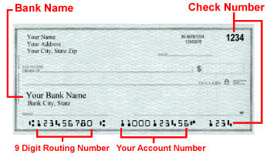
Mailings (continued)
A claimant can file an initial application for UC benefits through the Internet and can also sign up for Direct Deposit at the same time but they will need to have the necessary banking information (Bank Name and address, routing number, account number) for direct deposit.
Be aware that it can take 5 calendar days for Direct Deposit to activate, so until then, they must use their debit card to access benefits.
Direct Deposit
Payment Information (Debit Card or Direct Deposit) will be included with their Claim Confirmation Letter.
Direct Deposit is Good for two years

Slide 10
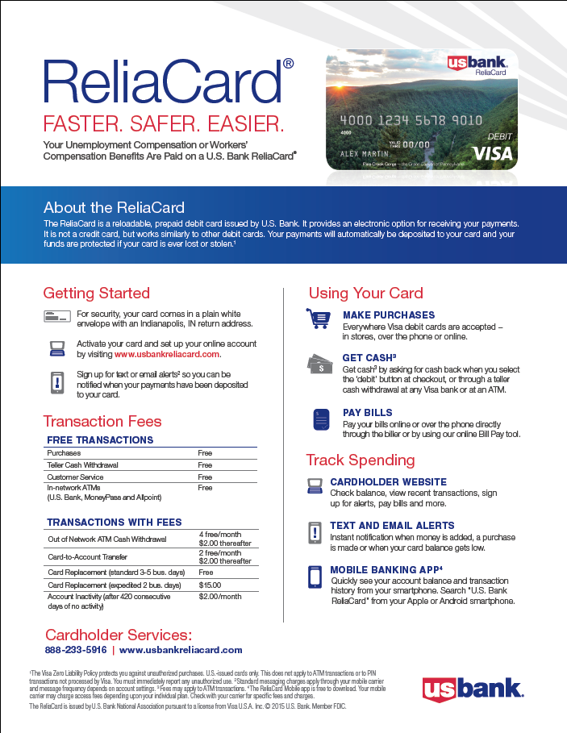

Mailings (continued)
Debit Card and UC Handbook
Debit Card
UC Handbook
The ReliaCard is mailed directly from US Bank. It is good for three years. A new card will not be issued until the current card expires.
The UC Handbook will only be mailed to individuals who open their claim through a live agent. They can also find a copy of our Handbook at our website, www.uc.pa.gov.

Slide 11
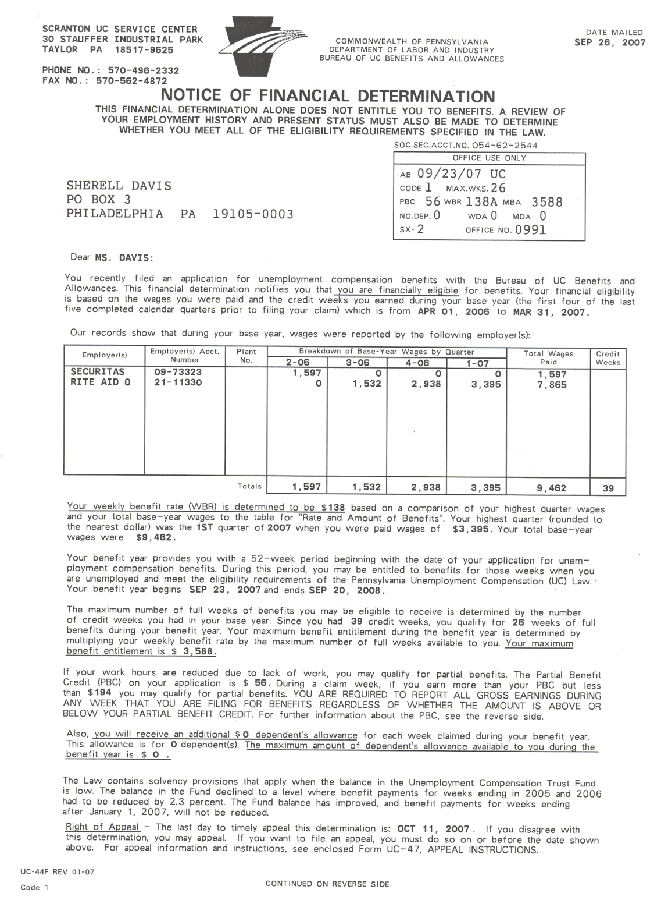
Mailings (continued)
Financial Determination
SSN
Sample Notice of Financial Determination
Their Base Year
Any and all employers and wages they had during their Base Year should appear on their Notice of Financial Determination.
They should review the wages we have on record for them. If they feel their wages are not correct or missing, they have the right to appeal the financial determination, and provide additional information to help us correct the possible issue. Due to the current volume of applications, we will be flexible with appeal deadlines.
Their Weekly Benefit Rate
Beginning & Ending Date of Their Claim
Their Maximum Entitlement
Their Partial Benefit Credit which pertains to part time work (30% of WBR)
Dependent Information
Their Appeal Rights

Slide 12
Weekly benefit rates
Notice of Financial Determination
Weekly rates range from $68 to $572 per week, but their Weekly Benefit Rate (WBR) will be determined by the highest total gross quarterly earnings they had during their Base Year.
The minimum amount of their WBR should be equal to at least 50% of their average gross weekly wage from the employer with which they earned the most money.
If their WBR is less than $572 but not 50% of their average gross weekly wage, they should contact the UC Service Center. (Max Rate – high qtr. - $14,538. yearly - $58,152)

Slide 13
Weekly benefit rates
Notice of Financial Determination
Additional weekly benefits can be claimed for up to two dependents (children under 18 or unable to work or a dependent spouse). The additional payments are $5 for first dependent and $3 for the second for a maximum of $8 per week (not exceeding 26 weeks).
*Please note a 2.4% rate reduction will be applied to all regular state UC payments due to low UC Trust Fund reserves. Because of this, their actual payment will be less than the WBR listed on your Notice of Financial Determination. For additional information please refer to our website www.uc.pa.gov.

Slide 14
UC eligibility requirements
Qualifying for UC Benefits – each topic listed below will be covered on the following slides.
In order to qualify for UC Benefits, the claimant must be
  Financially eligible (wages and credit weeks in their base year)
  Able and Available to accept work,
  Eligible based on their reason for separation,
  Alien Verification, if not a U.S. Citizen or a U.S. national, and
  If Ex-military, confirmation of reason for separation.

Slide 15
Uc eligibility requirements (continued)
Financial Eligibility – Base Year Wages
When a claim for benefits is filed, a Notice of Financial Determination, is mailed which indicates the amount of money (gross earnings) paid by all employers covered by UC law during a specific time period known as a “Base Year” which is…
The first four of the last five completed calendar quarters preceding the filing of the new UC claim.
For example, a claim filed in April, May or June of 2020, would have a base year consisting of:
^{1st} Qtr. 2019: Jan, Feb, Mar
2nd Qtr. 2019: Apr. May, June
3rd Qtr. 2019: July, Aug, Sept
4th Qtr. 2019: Oct, Nov, Dec
To be Financially Eligible, at least 37 percent of the total qualifying wage must have been paid in one or more quarters other than in their High Quarter.

Slide 16
Uc eligibility requirements (continued)
Financial Eligibility – Base Year Wages (continued)
Combined Wage Claim
A Pennsylvania "combined wage claim" is a UC claim based on earned wages in Pennsylvania and another state (including the District of Columbia, Puerto Rico, or the Virgin Islands) during the base year period. To file a combined wage claim in Pennsylvania, you must have worked in Pennsylvania during the base period of the UC claim you are filing. A request must be sent to the other state(s) to request a transfer of the wages to PA.
Base Year Wages over $99,999
Do to the limitations of our current UC System, the Financial Determination will not automatically process on claims with total Base Year wages over $99,999. In this situation, the Monetary Department must manually process and issue the claimant’s Financial Determination.

Slide 17
Uc eligibility requirements (continued)
Financial Eligibility – Credit Weeks
Additionally, the claimant must also satisfy the credit week requirement to be considered eligible to receive UC benefits. A credit week is any calendar week (Sunday through Saturday) within the base year in which an individual earned $116 or more, no matter when paid. They may have only one credit week per calendar week.
The total amount of UC benefits that they may receive during the benefit year is called the "maximum benefit amount" and is dependent on the number of credit weeks in their base year.
If they have at least 18 credit weeks, their maximum benefit amount is the amount corresponding to the number of credit weeks during their base year, multiplied by their weekly benefit rate.
However, their maximum benefit amount may not exceed 26 times your weekly benefit rate. They are not eligible to receive benefits if they have fewer than 18 credit weeks in the base year.

Slide 18
Uc eligibility requirements (continued)
Financial Eligibility – Credit Weeks
Individuals who do not meet wage and credit week requirements due to a work-related injury, may request a redetermination using an alternate base year.
This alternate base year consists of the four completed calendar quarters immediately preceding the date of the work-related injury. For the alternate base year rules to apply, the work-related injury must be compensable under the Workers' Compensation Act.
If they receive a Notice of Financial Determination indicating that they are ineligible for benefits and they want a calculation using the alternate base year rules, they must file a timely appeal from the determination and request a redetermination from the UC service center.

Slide 19
UC eligibility requirements (continued)
Able and Available
Individuals must remain Able for work and Available for work (A&A) to accept some form of employment during the pandemic, even if not in their customary occupation.
Therefore, being in quarantine alone, is not a reason to determine a person as not being A&A. If employment could theoretically be accepted, such as work-from-home opportunities, then the person remains able and available for work.
Our interpretation of Able and Available will be very liberal for this time period.

Slide 20
Uc Eligibility requirements (continued)
Reason for Separation
The claimant must have a qualifying separation from their last employer. Most commonly, if they were discharged or quit their employment, these types of issues must be reviewed by the department, who will determine their eligibility based on their separation as it relates to Pennsylvania UC Law. Once the review is completed, a determination will be mailed to the claimant informing them of our decision.
The determination process can take up to 6 weeks, and claimants are instructed to continue filing their biweekly claims timely while waiting for the determination in the mail. If the claimant is found eligible based on the separation issue, pended weeks will be released for payment the date the determination is made.

Slide 21
Uc Eligibility requirements (continued)
Reason for Separation
A “Lack of Work” due to the closure of their employer (permanent or temporary) is not considered a discharge or quit from employment.
Any determinations issued by the UC Service Center can be appealed if the claimant disagrees. Appeals must be filed within 15 calendar days of the mailing date shown on the UC Service Center determination.
The claimant is advised to carefully review any determination for accuracy and for the “last day to appeal” date listed. Due to the current volume of applications, we will be flexible with appeal deadlines.

Slide 22
Uc Eligibility requirements (continued)
Alien Verification
If the claimant is not a U.S citizen or U.S. national, they will be required to enter their alien registration number, including the date they were first authorized to work in the U.S. as well as the authorization expiration date, when opening a brand new claim.
They must also provide us a copy, both front and back, of their social security card and their current work authorization documents. A claimant can be advised to send an legible copy of the documents to one of our call centers or email to greencard@pa.gov.

Slide 23
Uc Eligibility requirements (continued)
Ex-Military
Those recently completing military service can be advised to mail, fax or email a copy of their DD-214 Member 4 form (confirms the reason of separation, which must be honorable) to the following address:
Federal Programs Unit
L & I Bldg., Room 604
651 Boas Street
Harrisburg, PA 17121
Fax: 717-772-0378
Email: ra-li-bucb-paipc@pa.gov

Slide 24
Filing biweekly claims for benefits
How to receive payments
After filing an application, in order to actually receive benefits, they must claim each week they are unemployed (including their “waiting week”). A claim week is a Sunday through Saturday calendar week. In most cases they will file for two claim weeks at one time. This biweekly claiming must be done every other week for as long as they are not working their normal or full time hours.
Note: when they file an initial application they will be instructed when to file their first biweekly claim. Please note that after completing a biweekly claim, the system will then automatically inform them of their next filing date.

Slide 25
Filing biweekly claims for benefits
How to receive payments
If they want to file by internet, log on to www.uc.pa.gov then click on “File a Biweekly Claim.”
  Then enter their UC PIN and SSN
  They must then answer a series of basic Yes or No questions about the two previous weeks.
Biweekly claim’s filing is available Sundays from 6 AM to 11 PM and Monday through Friday from 6 AM to 9 PM.
Automated biweekly claims filing is also available by using PA Teleclaims, or PAT, by calling 888-255-4728 (Spanish PAT # 877-888-8104)
If needed: UC TTY Service available at 888-334-4046
It may be possible that the claimant’s first biweekly claim is not ready for them to file on their filing date. The claimant should be advised to be patient and to not further delay their claim by applying or reopening their claim unnecessarily again. Such repeated reopening of their claim slows down the processing of the first application/reopening.

Slide 26
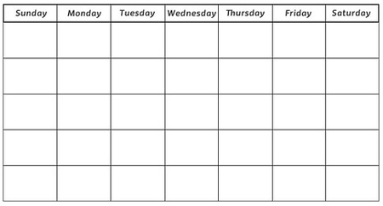

What to Expect When You Open an Unemployment Claim
You are not unemployed if you receive a regular salary or are using paid leave, even if you are not working. Only individuals who are working less and therefore are receiving less pay are considered unemployed.
Similar to working for two weeks and getting a paycheck a couple days/weeks later, UC works the same way. After the weeks are over, you tell us if you were unemployed and then we send payments.
Continue every 2 weeks until either you are no longer unemployed, or your benefits are exhausted/expired.
The first week you are not working, or working less, is here
No matter which day you submit your new claim application – Sunday through Saturday – your claim will be effective Sunday and remains in effect for one year, with anywhere from 18-26 full weeks of payments available.
Two Sundays later, you will use your PIN to certify if you were unemployed for those first two weeks and answer several questions. You will do this either online or by using PAT, and you have from Sunday through Friday of that week to complete this task.
If we have no further questions, you receive payment in 2 days (3 if you file your claims certifications on Sunday).

Slide 27



Filing biweekly claims – calendar
Laid Off
Waiting Week must be a payable week
1st Claimable Week – Possible Waiting Wk
Application Beginning Date of Claim
First Week Ending (If new claim, Possible Waiting Wk.)
File Initial Claim / Reopen Existing Claim
Second Week Ending
2nd Claimable Week
File first biweekly claim
3rd Claimable Week
2 week of benefits
4th Claimable Week
File second biweekly claim
2 weeks of benefits
FPUC Payment, $600 per week effective the week ending 04/04/20. Paid Tuesday or Wednesday.

Slide 28
Filing biweekly claims (continued)
2 weeks of benefits
File biweekly claim
2 weeks of benefits
2 weeks of benefits
File biweekly claim
2 weeks of benefits
2 weeks of benefits
File biweekly claim
2 weeks of benefits
FPUC Payment, $600 per week effective the week ending 04/04/20. Paid Tuesday or Wednesday.

Slide 29
Changes to requirements and important tips
Department actions and things to keep in mind – each topic listed below will be covered on the following slides.
Waiting Week Requirement Suspended
Work Search and Work Registration requirements are temporarily waived for all UC claimants
Reopening an Existing Claim
Filing for Partial UC Benefits
UC Benefit Payments
UC Debit Card (ReliaCard) and Direct Deposit
Distributions of emp. pensions or 401K plans as well as any severance package payments
Support orders
Social Security
Vacation Pay
Federal Tax Withholding
www.uc.pa.gov

Slide 30
Changes to requirements
Waiting Week, Work Search, Work Registration
The Waiting Week is suspended
  Previously, claimants were not eligible for benefits during their first week of unemployment (the "waiting week.") This has been suspended; eligible claimants may receive benefits for the first week that they are unemployed, effective the week ending 03/21/20, per Governor’s Emergency Directive.
Work Search and Work Registration Waived
  These requirements are temporarily waived for all UC claimants effective the week ending 03/21/20. Claimants are not required to prove they have applied or searched for a new job to maintain their UC benefits. Claimants are also not required to register with www.PACareerLink.pa.gov.

Slide 31
Important tips
Reopening an Existing Claim
If a claimant opened a claim within the last twelve months, their PIN and Notice of Financial Determination were already issued when they opened that claim. They won’t receive additional mailings. It is good for the entire year of the claim. Therefore it is important for the claimant to retain the initial information for future reference.
If a claimant needs to reset their PIN, please advise them they can request a PIN reset online at our Contact Us page (bottom of uc.pa.gov, click on the Contact Us button). They should only request it once. If they do it multiple times, this can cause extended delays.
If they reopened their existing claim, this will be the only time they should do so unless they go back to work and are subsequently unemployed. A staff member must manually process the reopen that they submitted online, and the department is working through the thousands of reopens we receive daily.

Slide 32
Important tips (continued)
Reopening an Existing Claim
It may be possible that their biweekly claim is not ready for them to file on their first scheduled filing date. Advise them be patient and do not further delay their claim by using this application to reopen their claim again. Such repeated filings slow down the processing of their first application/reopening of their claim.
If the biweekly filing system tells them on their filing date that their weeks are inactive, advise them to simply try filing their biweekly claims one time each day until they can successfully file. Biweekly filing is not available on Saturdays.

Slide 33
Important tips (continued)
Filing for Partial Benefits
Partial Benefits can be paid if the claimant works less than full time or their normal work hours and their weekly gross wages are less than your Weekly Benefit Rate (WBR) + 30% (known as Partial Benefit Credit, PBC), also known as their Combined Rate.
Should they begin working part time after establishing their claim, they should be advised to contact the UC Service Center as soon as possible with the name and address of the new employer and for additional instructions on claiming partial benefits.
Example of Part-time Earnings
Claimant’s Gross Weekly Wage $ 200
Claimant’s Weekly Benefit Rate (WBR) $ 100 (Financial Determination)
(Remember, the WBR should be approx. 1/2 of the Gross Weekly Wage)
Partial Benefit Credit (PBC) $ 30 (Financial Determination)
(PBC is 30% of WBR, 30% X $100 = $30)
Combined Rate $ 130
(Weekly Benefit Rate + Partial Benefit Credit)

Slide 34
Important tips (continued)
Filing for Partial Benefits
1st Week part time earnings $30, 2nd Week part time earnings $40. How much would claimant be entitled to for each of the two weeks?
1st Week – Since the earnings of $30 is equal to or less than the PBC of $30, the claimant would still be entitled to the full WBR of $100.
2nd Week – Since the earnings of $40 is $10 dollars over the PBC of $30, we would deduct $10 from the WBR of $100, and the claimant would only be entitled to $90 for the second week.

Slide 35
Important tips (continued)
UC Benefit Payments
If a claimant is inquiring about a benefit payment and they’ve received a ReliaCard, advise them to check the balance on the Debit Card. If they’ve checked the debit card, and the payments have not been received; advise them to check their bank account for a direct deposit. When and where benefits are paid can be monitored on the UC Website through Benefit Payment History.
Questions about the UC Debit Card or Direct Deposit
Do not refer inquiries as to why payment has not yet been received to the phone numbers below. These numbers are to address debit card and direct deposit issues only. US Bank and UC Treasury cannot access the UC Claim Record.
Debit Card - U.S. Bank Reliacard: 888-233-5916
Direct Deposit - UC Treasury: 877-869-1956

Slide 36
Important tips (continued)
Pensions, 401k, Support Orders, Social Security, Vacation Pay
Distributions of emp. pensions or 401K plans as well as any severance package payments (over $21,900 for severance only), may reduce benefits under certain circumstances.
Support orders are automatically deducted if applicable.
Social Security is not deductible from UC benefits.
Vacation Pay is only deductible if you have a definite recall date.
UC benefits are considered income for federal tax purposes only, not State or Local. The claimant has the option of having 10% of their Weekly Benefit Rate (including any dependent allowance) withheld for tax purposes. A UC-1099G will be issued in January reflecting the amount paid and the amount withheld.

Slide 37
Important tips (continued)
What’s available on www.uc.pa.gov
Many general UC functions can be performed online, such as:
Open a new claim for UC benefits.
Access the most up-to-date information on the department’s Covid-19 response.
View instructional videos and documents to answer general UC questions. This information can be found under FAQs, then selecting the “Claimant” option.
The following functions can be performed online, as long as the claimant has/knows their UC PIN (Personal Identification Number):
Reopen an existing Unemployment Claim.
File a biweekly claim.
Change of address, telephone/fax numbers or email address.
Start or change direct deposit.
Access UC benefit payment history.
View/print their UC-1099G for tax purposes.
View or pay their UC overpayment.
File an appeal.
Change their UC PIN or Federal Tax Withholding (this can also be done through the PA Teleclaims System, or PAT).

Slide 38

Contacting UC
LiveChat
A claimant can use the UC Live Chat feature to speak to an UC representative electronically. We are experiencing very high call volumes at this time.
UC Live Chat is available Mon-Fri, 7 AM – 6 PM.
The UC Chat feature can be found in various locations on our website. On the homepage of the Pennsylvania Unemployment Compensation website, scroll down slightly. The UC Live Chat link can be found under the main COVID-19 banner on the page.

Slide 39
Contacting UC
LiveChat
General UC questions can be answered through the chat without any personal information being exchanged.
Questions specific to their claim - More than likely, most of the contacts we receive involve someone who actually needs to interact with a person. Questions like…
  Why didn’t I receive my payment?
  What is the status of my claim? (adjudication, monetary and appeals questions)
  No PIN or they haven’t received information regarding their new UC claim.
When the claimant has questions specific to their claim, the chat representative will take additional steps to verify their identity. This is for the safety and security of their personal information and their UC Claim. If the claimant does not wish to provide their personal information to a representative electronically, a call to the UC Service Center will be necessary.

Slide 40
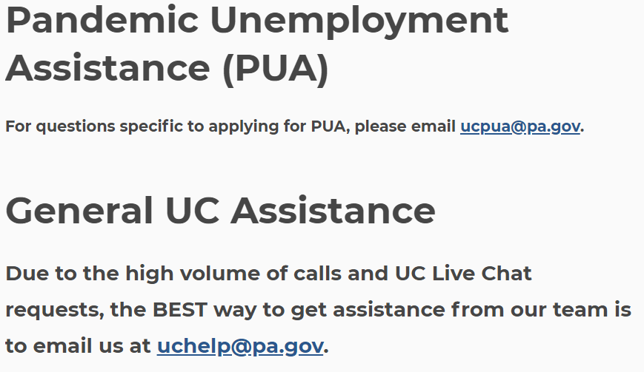
Contacting UC
Email
A claimant can Email a Customer Service Representative through UCHelp@pa.gov or UCPUA@pa.gov
  (Using this method, a response is generally received within 16 business days.)
Due to the overwhelming number of emails the department is receiving, the turnaround time using this method has increased. We are working around the clock to provide assistance to the citizens as quickly as possible.
To alleviate longer interaction times, claimants must provide their full name, as it appears on their claim (including middle initial or suffix, if applicable), and the last four digits of their Social Security Number.
On the UC website, follow these steps to contact the UC Service Center via email:
Scroll down to the bottom of the home page. In the light gray area, click on the blue button that reads “Contact Us”
On the next page, scroll down slightly and you’ll see the UC Help email link.
To open an email, click the link.

Slide 41
Contacting UC
Phone
Fax numbers:
Altoona UC Service Center 814-941-6801
Scranton UC Service Center 570-562-4385
Erie UC Service Center 814-871-4863
Indiana UC Service Center 724-599-1068
Duquesne UC Service Center 412-267-1475
Harrisburg UC Service Center 717-214-5463
(New) UC Virtual Assistant Powered by Watson - PAULA
  The public can call 877-978-1295 to ask frequently asked questions and receive answers from a virtual database.
  PAULA can answer general UC questions answers only, and cannot access the claimant’s specific UC claim record or transfer caller to a live agent.
UC Service Center (8am to 4pm Monday – Friday)
  UC Service Center statewide toll-free number: 888-313-7284
  TTY Services for Deaf and Hard-of-Hearing Toll-Free: 888-334-4046
  Videophone Service for ASL Users: 717-704-8474
    (Wednesdays and Fridays Noon-4 p.m.) *Sign language is the ONLY means of communication provided at this number.
Notes:
PAULA = PA Unemployment Link Assistant

Slide 42
Federal Cares act
What has Changed in UC for 2020
Federal Pandemic Unemployment Compensation (FPUC)
Pandemic Unemployment Assistance (PUA)
Pandemic Emergency Unemployment Compensation (PEUC)
For the most up-to-date information on these programs, please refer to our web site, www.uc.pa.gov.

Slide 43
Federal Cares act
Federal Pandemic Unemployment Compensation (FPUC) – the first program
This Program provides eligible individuals with $600 per week in addition to the weekly benefit amount they receive from certain other UC programs. Individuals are only entitled to benefits if they are no longer working through no fault of their own and that individuals must be able and available to work. Quitting work without good cause to obtain additional benefits under the regular UI program of the CARES Act qualifies as fraud.
This program provides an additional $600 per week to individuals who are collecting regular UC, as well as the following unemployment compensation programs:
  Pandemic Emergency Unemployment Compensation (PEUC);
  Pandemic Unemployment Assistance (PUA);
  Trade Readjustment Allowances (TRA);
  Shared-Work.
The first week for which FPUC may be paid is the week ending April 4, 2020. The last week that FPUC may be paid is the week ending July 25, 2020.
The cost of these additional $600 payments to eligible individuals each week is 100% federally funded.
Department of Labor, UI Program Letter No. 15-20, 04/04/20

Slide 44
Federal Cares act
Federal Pandemic Unemployment Compensation (FPUC)- Continued
This additional payment will not be included in the regular UC biweekly payment, it will be paid the week after, and will include 2 weeks (2 x $600 = $1200) of FPUC benefits. FPUC benefits will be paid biweekly, during the off week of the UC benefits.
FPUC is taxable, and claimants will have the option to choose if they want 10% withheld for federal income tax from the $600.
Claimants will be eligible for FPUC benefits if they are entitled to receive at least $1 of unemployment benefits for that week.
Claimants will not be entitled to FPUC for weeks with excess earnings, pension or severance that reduce payment to $0, or if they are filing penalty weeks resulting from a fault overpayment.
Claimants with a UC overpayment will be entitled to the payment, even if their entire weekly benefit is applied to their overpayment.
These payments started to be issued during the week ending April 18, 2020.
Department of Labor, UI Program Letter No. 15-20, 04/04/20

Slide 45
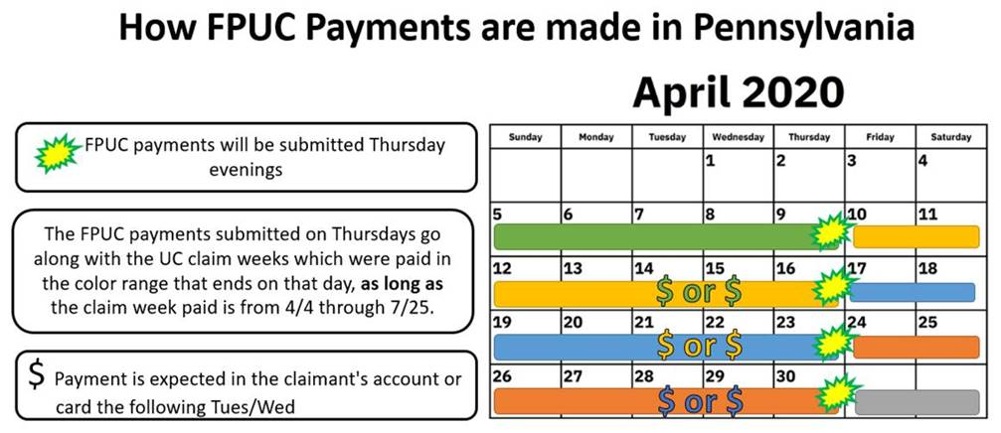
Federal cares act
Federal Pandemic Unemployment Compensation (FPUC)- Continued

Slide 46
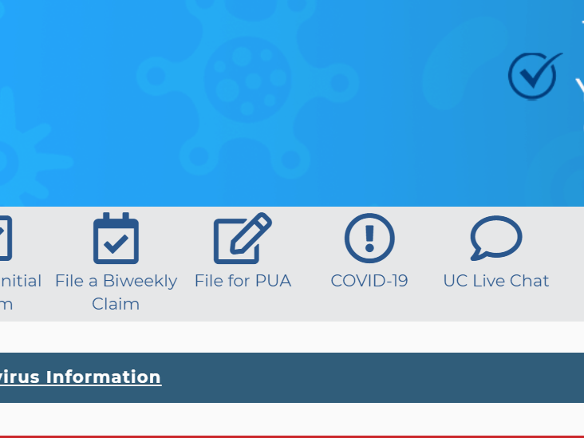

Federal Cares act
Pandemic Unemployment Assistance (PUA) – the second program
The PUA program generally allows states to pay up to 39 weeks of benefits to individuals who are not eligible to receive or who have exhausted regular unemployment compensation (UC) or Pandemic Emergency Unemployment Compensation (PEUC). The costs of the new federal benefit and of program administration are 100% federally funded. “Covered Individuals” include -
  Self-employed,
  Individuals seeking part-time employment,
  Individuals lacking sufficient work history, or
  Those otherwise not qualified for regular UC, extended benefits under state or federal law, or PEUC.
PUA must be paid starting with the weeks of unemployment beginning on or after January 27,2020, if the individual meets PUA’s eligibility requirements. In states where the week of unemployment ends on Saturday, the first week for which PUA may be paid is the week ending February 8, 2020. States may not make PUA payments with respect to weeks of unemployment ending after December 31, 2020.
Department of Labor, UI Program Letter No. 16-20, 04/05/20
Individuals can begin filing their initial application for PUA now at uc.pa.gov

Slide 47
Federal Cares act
Pandemic Unemployment Assistance (PUA)-Continued
To be a “covered individual” under PUA, an individual must also self-certify that he/she is otherwise able to work and available for work, except that the individual is unemployed, partially unemployed, unable to work or unavailable for work due to at least one of the following categories below.
  The individual has been diagnosed with COVID-19 or is experiencing symptoms of COVID-19 and is seeking a medical diagnosis.
  A member of the individual’s household has been diagnosed with COVID-19.
  The individual is providing care for a family member of the individual’s household who has been diagnosed with COVID-19.
  A child or other person in the household for which the individual has primary caregiving responsibility is unable to attend school or another facility that is closed as a direct result of COVID-19 public health emergency and such school or facility care is required for the individual to work.
  The individual is unable to reach the place of employment because of a quarantine imposed as a direct result of the COVID-19 public health emergency.
Department of Labor, UI Program Letter No. 16-20, 04/05/20

Slide 48
Federal Cares act
Pandemic Unemployment Assistance (PUA)- Continued
  “Covered individual(s)” continued:
    The individual is unable to reach the place of employment because the individual has been advised by a health care provider to self-quarantine due to concerns related to COVID-19.
    The individual was scheduled to commence employment and does not have a job or is unable to reach the job as a direct result of the COVID-19 public health emergency.
    The individual has become the breadwinner or major support for a household because the head of the household has died as a direct result of COVID-19.
    The individual has to quit his or her job as a direct result of COVID-19.
    The individual’s place of employment is closed as a direct result of the COVID-19 public health emergency.
    The individual meets any additional criteria established by the Secretary for unemployment assistance under this section.
Department of Labor, UI Program Letter No. 16-20, 04/05/20

Slide 49
Federal Cares act
Pandemic Unemployment Assistance (PUA)- Continued
Other examples of individuals covered by this program:
  Sole-proprietors;
  Farmers;
  Independent Contractors;
  Corporate Officers, etc.
The base period to be utilized in computing the PUA weekly amount shall be the most recent tax year that has ended for the individual prior to the individual’s unemployment that was a direct result of the major disaster. (DUA, 20 CFR 625.6)
The claimant must complete a self-certification form (either paper or on-line) to apply for this program.
The weekly self-certification for benefits can be filed at https://pua.benefits.uc.pa.gov.
It is important to note that unlike regular Unemployment Compensation, no PIN numbers are assigned nor required by the claimant to access their PUA claim or to certify their weeks for benefits.
Department of Labor, UI Program Letter No. 16-20, 04/05/20

Slide 50
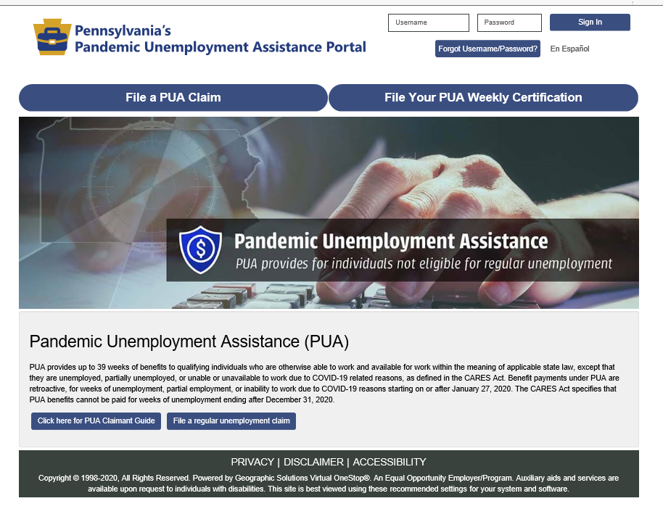
Federal Cares act
Pandemic Unemployment Assistance (PUA)- Continued
https://pua.benefits.uc.pa.gov
A PUA Claimant Guide can be found at this web site which will provide information on how to:
Register and File their Initial PUA Claim.
File their PUA Weekly Certification for Benefits.
Check their Claim Status and Payment Details.
Check their Message Center for Claim Notifications.

Slide 51
Federal Cares act
Pandemic Unemployment Assistance (PUA)- Continued
If an individual has questions or needs assistance regarding PUA, They can contact us by calling 855-284-8545, Fax 717-772-0378 or by email at UCPUA@pa.gov.
Please Note: This email address is for PUA questions only. Emails not related to PUA will not receive a response.

Slide 52
Federal Cares act
Pandemic Emergency Unemployment Compensation (PEUC) – the third program
The PEUC program allows states to pay up to 13 weeks of benefits to individuals who:
  have exhausted all rights to regular unemployment compensation under state or Federal law;
  have no rights to regular UC under any other state or Federal law;
  are not receiving compensation under the UC laws of Canada; and
  are able to work, available for work, and actively seeking work, while recognizing that states must provide flexibility in meeting the “actively seeking work” requirement if individuals are unable to search for work because of COVID-19, including because of illness, quarantine, or movement restriction.
For purposes of PEUC eligibility, an individual is deemed to have exhausted benefits when:
  no payments of regular UC can be made under state law because such individual has received all available regular UC based on employment or wages during such individual’s base period; or
  the individual’s right to such regular UC has been terminated by reason of the expiration of the benefit year with respect to which such rights existed (excluding any benefit year that ended before July 1, 2019).
Both the costs of the new Federal benefits and the costs of program administration are 100% federally funded.
Department of Labor, UI Program Letter No. 17-20, 04/10/20

Slide 53
Federal Cares act
Pandemic Emergency Unemployment Compensation (PEUC)-Continued
An individual is deemed to have exhausted his/her right to regular compensation under a State law when:
  no payments of regular compensation can be made under such law because such individual has received all regular compensation available to such individual based on employment or wages during such individual’s base period; or
  such individual’s rights to such compensation have been terminated by reason of the expiration of the benefit year with respect to which such rights existed.
Exhaustees cease to be exhaustees when they can establish a valid new benefit year.
If the individual can establish a new benefit year in the filing State or in any other state, the individual may not continue to collect PEUC.
Claimants who have exhausted there 26 weeks of regular UC benefits, and are currently filing for TRA, would be rolled over onto PEUC with the first week ending April 4, 2020.
The first week for which PEUC may be paid is the week ending April 4, 2020.
PEUC is only payable for weeks of unemployment ending on or before December 31, 2020.
Department of Labor, UI Program Letter No. 17-20, 04/10/20

Slide 54
Federal Cares act
Pandemic Emergency Unemployment Compensation (PEUC)-Continued
The WBA payable to an individual for a week of total unemployment is equal to the amount of regular compensation (including dependents’ allowances) payable to such individual during the applicable benefit year for a week of total unemployment under the applicable state law.
The amount established in the PEUC account must be equal to 13 times the individual’s average weekly benefit amount (including dependent’s allowances).
The State must identify individuals who are potentially eligible for PEUC and provide them with appropriate written notification of their potential entitlement to PEUC, including filing instructions. This includes notifying individuals who have established a claim with a benefit year ending after July 1, 2019 and who have either exhausted their entitlement or whose benefit year has expired.
Applications for PEUC can be file on our web site, www.uc.pa.gov, by clicking on File for PEUC.
These payments started to be issued during the week ending May 25, 2020.
Department of Labor, UI Program Letter No. 17-20, 04/10/20

Slide 55
Questions?

